Slide 1
PHP Project
Name: Xin Luo
NEUID: 001873108

Slide 2
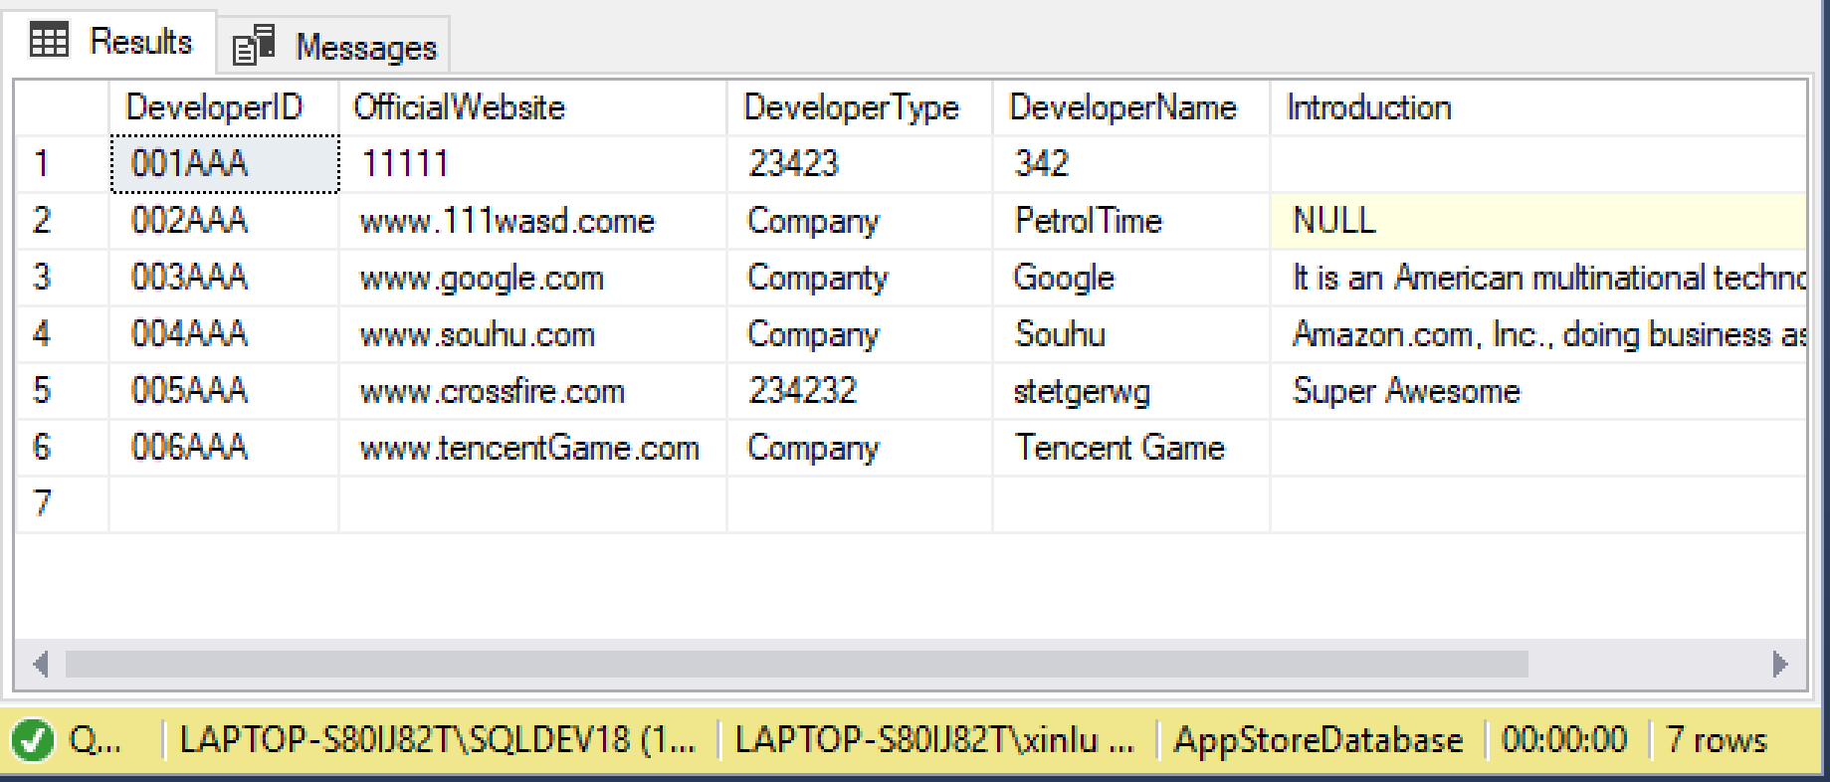
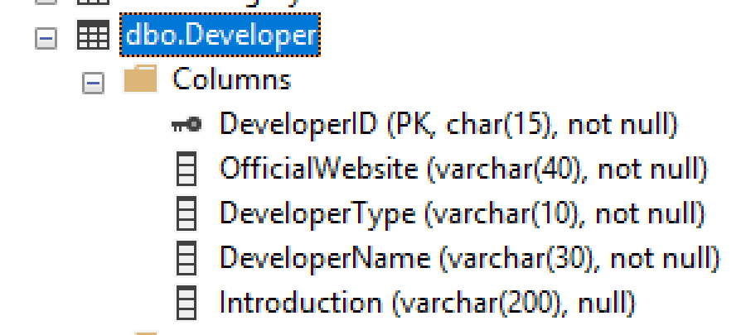
Related Table - Developer

Slide 3
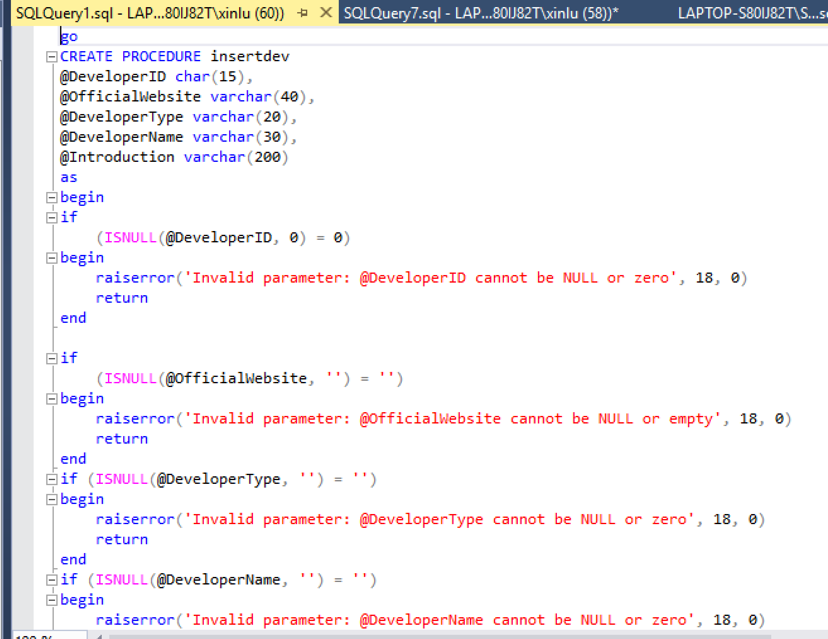
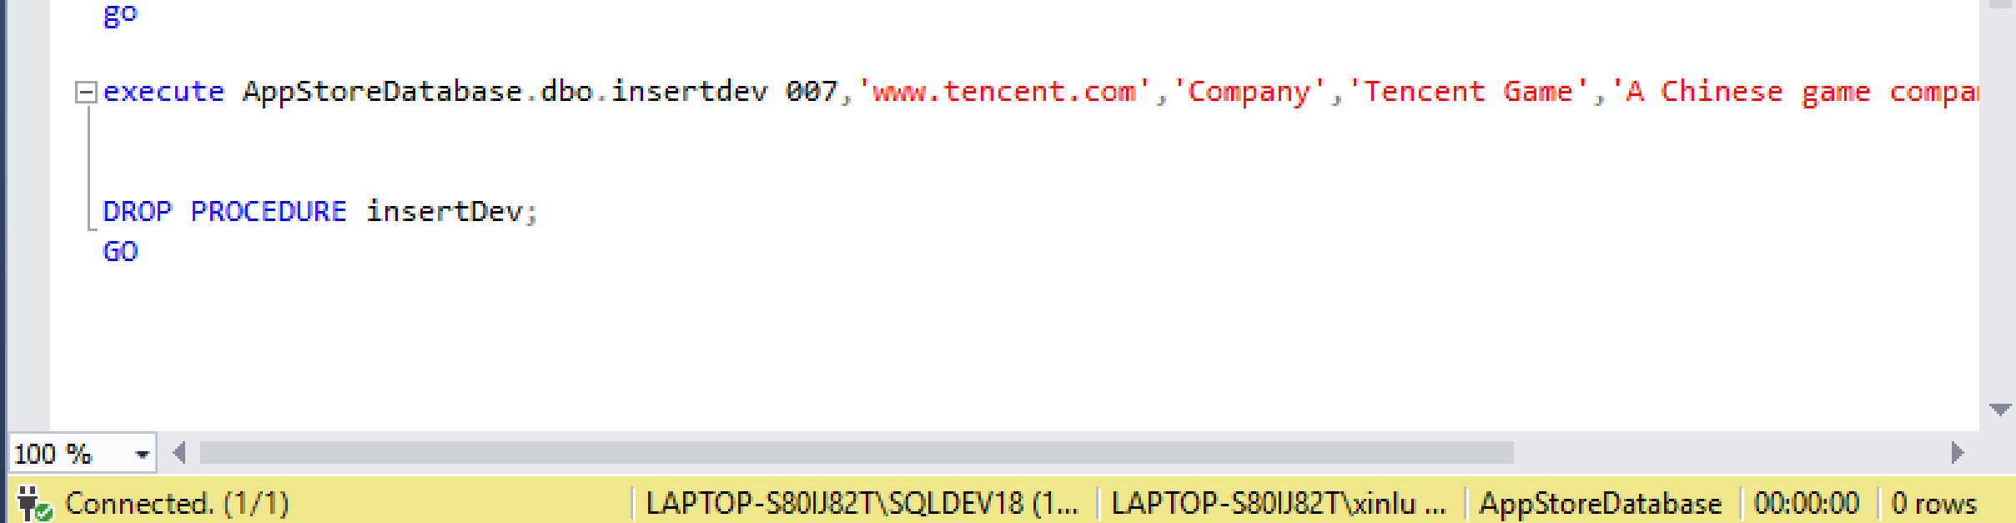
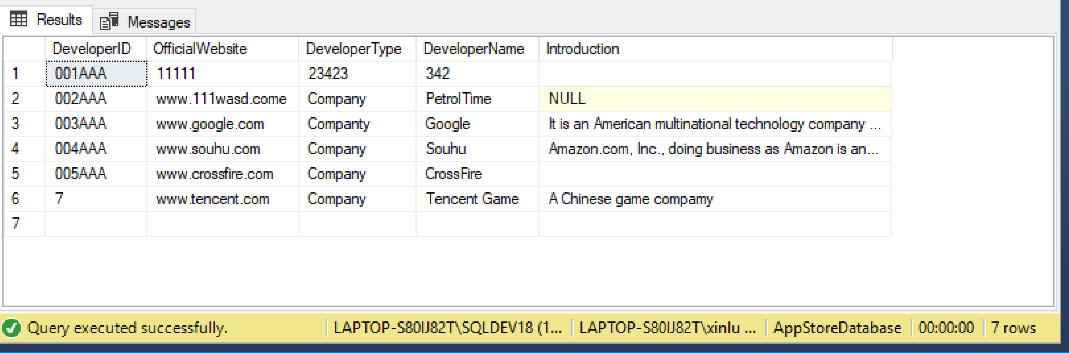
Extra Part 1_Insert Procedure

Slide 4
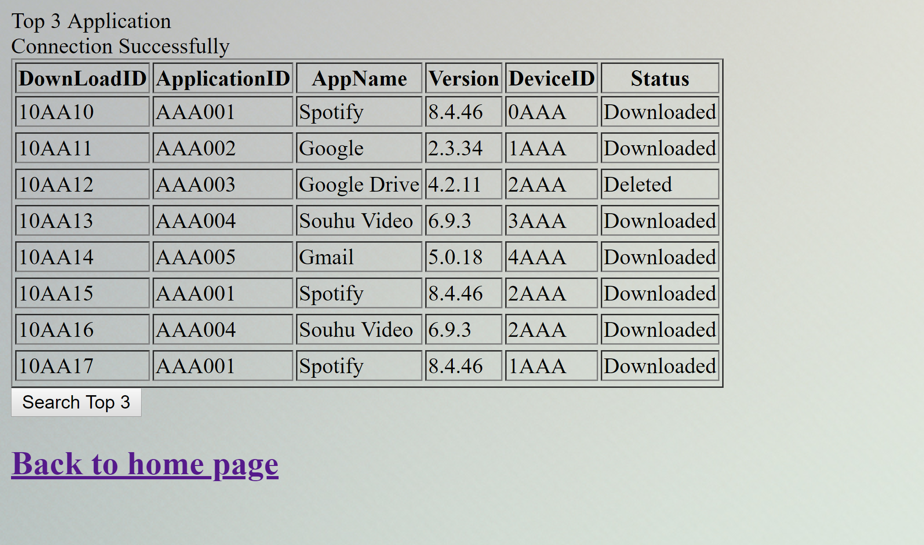
Extra Part 2_Top 3 Application Query

Slide 5
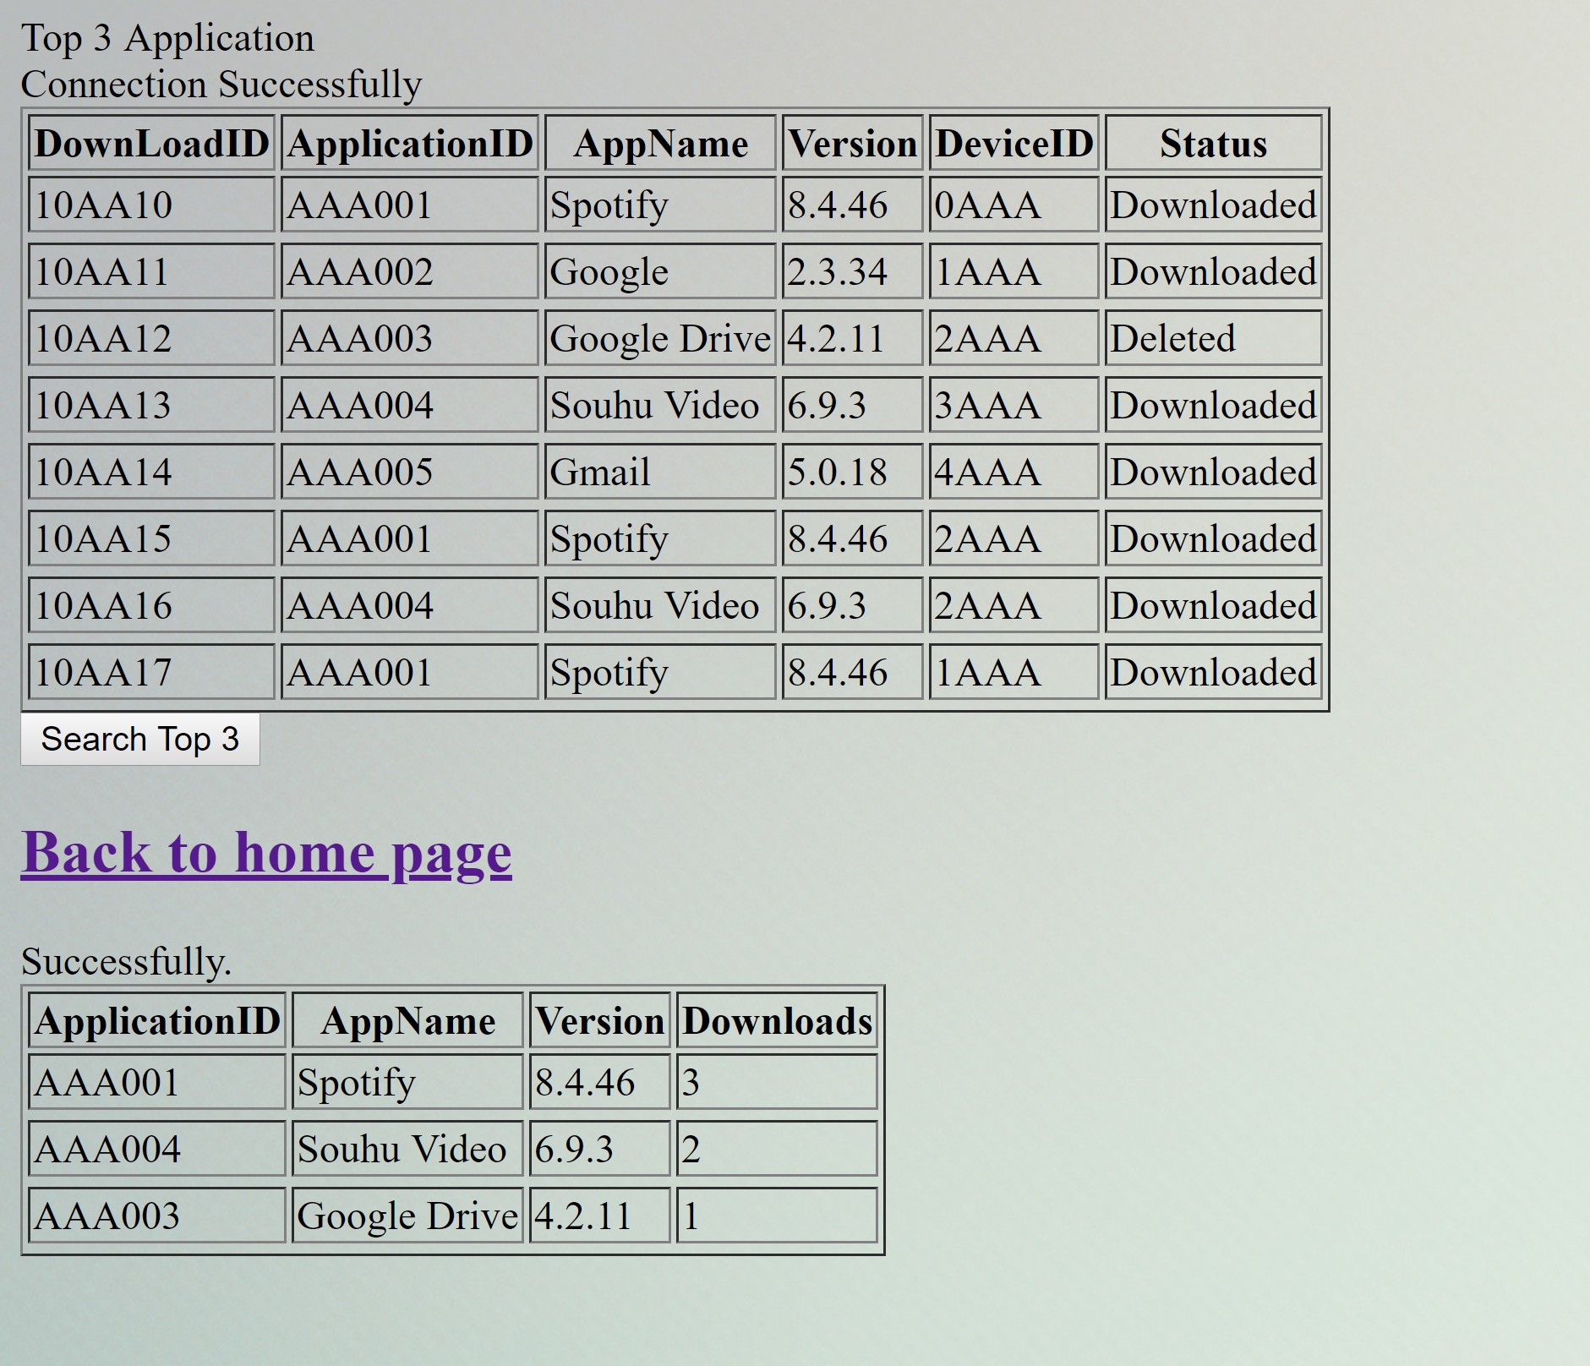
Extra Part 2_Top 3 Application Query

Slide 6
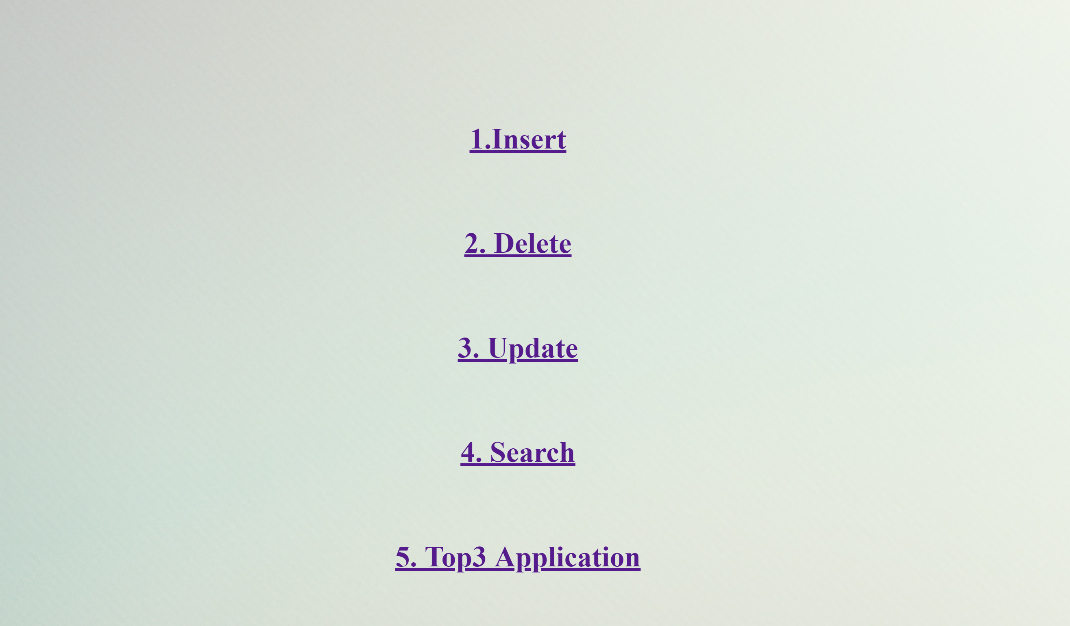
First Page
Linked table: Developer

Slide 7
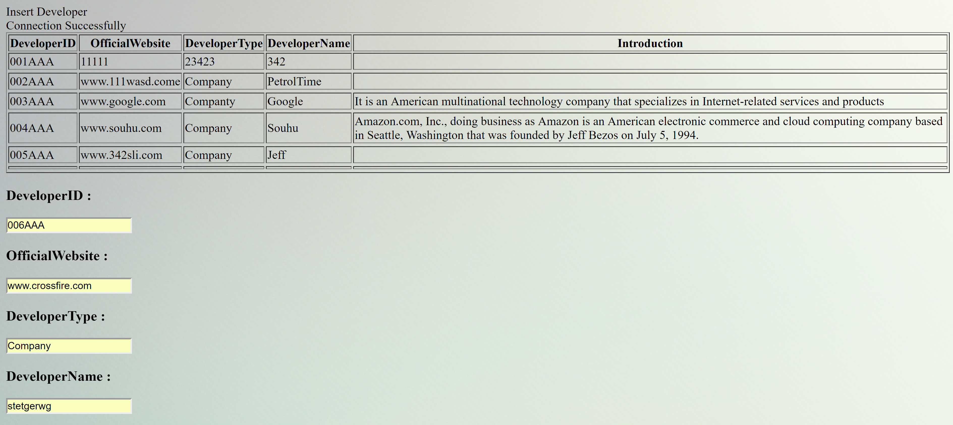
Insert Part

Slide 8
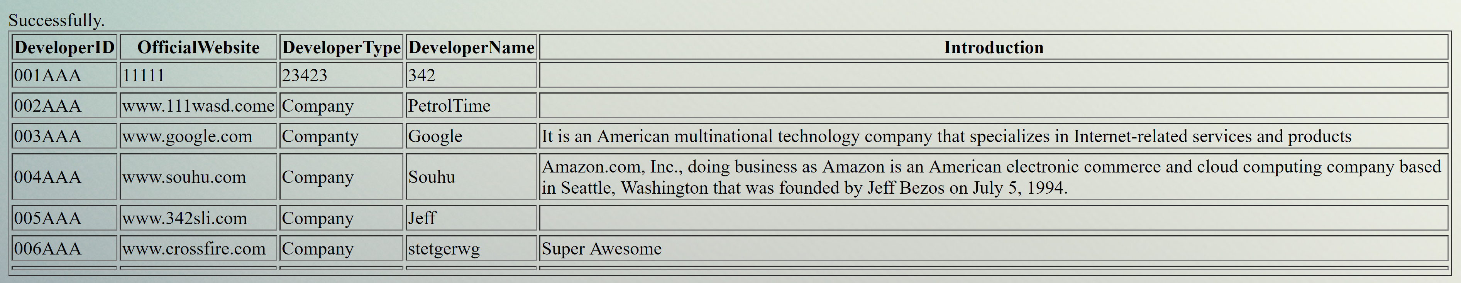
Insert Part

Slide 9
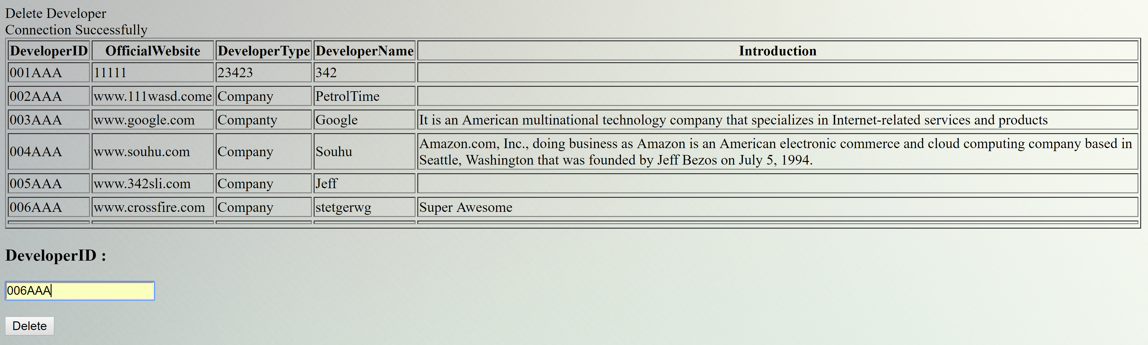
Delete Part

Slide 10
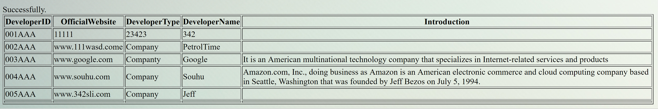
Delete Part

Slide 11
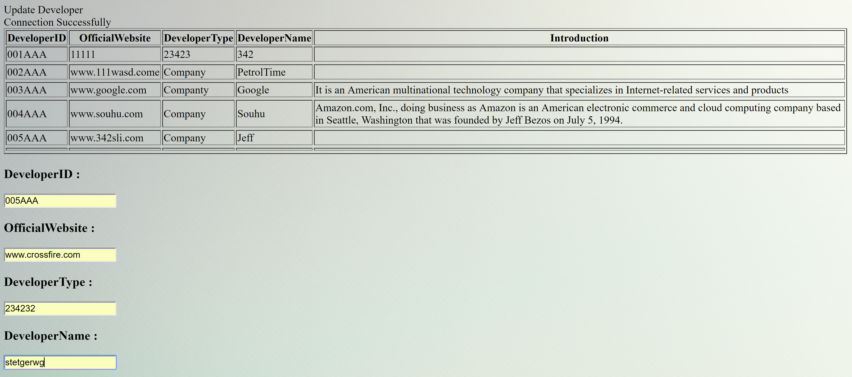
Update Part

Slide 12
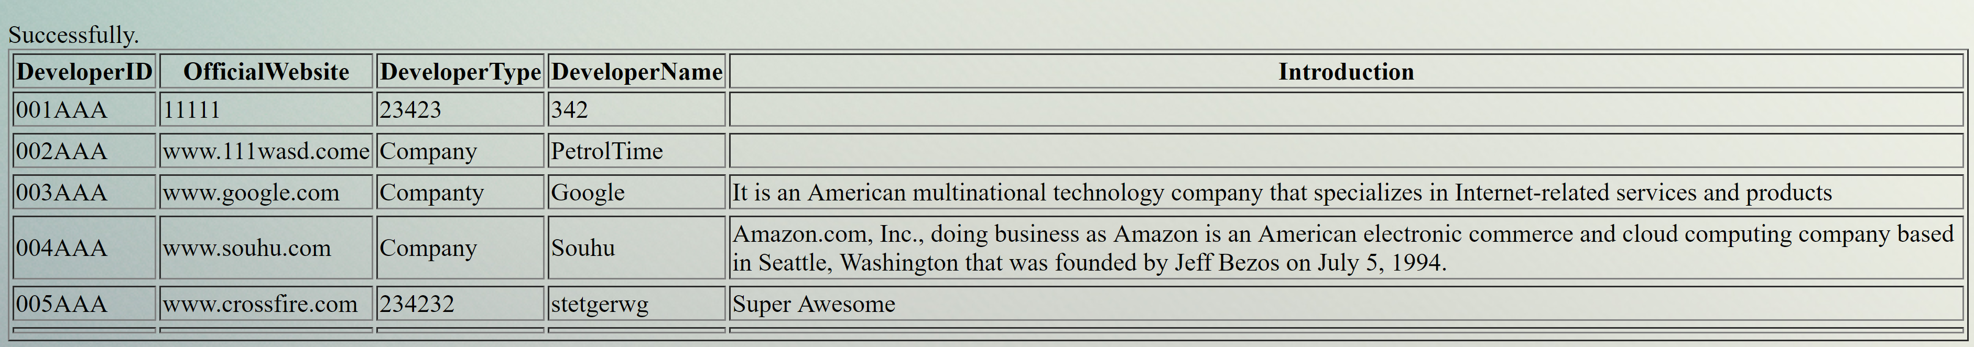
Update Part

Slide 13
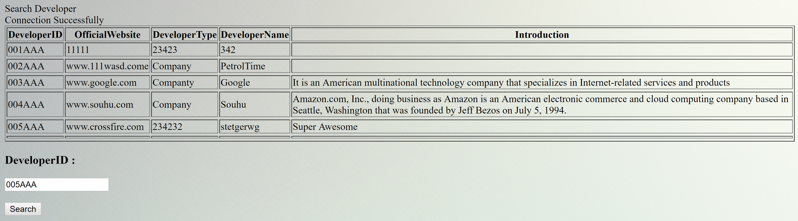
Search Part

Slide 14
Search Part

Slide 15
Thank you!
Name: Xin Luo
NEUID: 001873108

